Slide 1
FOOD ORDERING SYSTEM
Project Team Members:
1. Alla Pranay Ketan Reddy 7. Pilaka vamsi
2. Bandaru Omkar Karthikeya 8. Vukka Rachana
3. Ramakuru Lakshman 9. Banda Hari Priya
4. Ganjikuntla Mounika 10. Prudhvi Harshitha
5. Pamala Dinesh 11. Pattapuraju Sneha
6. Udayagiri Sreeja 12. Korapala Sai Shreya

Slide 2
BAN
BITE-AT-NIGHT

Slide 3
Abstract
ONLINE FOOD DELIVERY SYSTEM is a website designed primarily for use in the food delivery industry.
This system will allow hotels and restaurants to increase scope of business by reducing the labor cost involved.
The system also allows to quickly and easily manage an online menu which customers can browse and use to place orders with just few clicks.
Restaurant employees then use these orders through an easy to navigate graphical interface for efficient processing.

Slide 4
INTRODUCTION
Online ordering system that I am proposing here, greatly simplifies the ordering process for both the customer and the restaurant. System presents an interactive and up-to-date menu with all available options in an easy to use manner. Customer can choose one or more items to place an order which will Land in the Cart
Customer can view all the order details in the cart before checking out. At the end, customer gets order confirmation details. Once the order is placed it is entered in the database and retrieved in pretty much real time. This allows Restaurant Employees to quickly go through the orders as they are received and process all orders efficiently and effectively with minimal delays and confusion

Slide 5
AGENDA
Provide a display that will allow the customer to choose menu items.
Customization is applicable for particular orders.
At order finalization, we will request identification information from the customer.
Can handle a large number of orders at once and automatically calculate the bill.
One of the goals is to increase client-customer communication.

Slide 6
Steps to order using Code
Select your taste and type the number of the item.
Now select the type of the flavor and type the number.
Please choose the quantity that how many you want and order again.
Choose a payment type and give your payment details to pay.
02
03
04
05
Register and login with your new ID and password details
Choose your order type and give your valuable feedback.
01
06

Slide 7
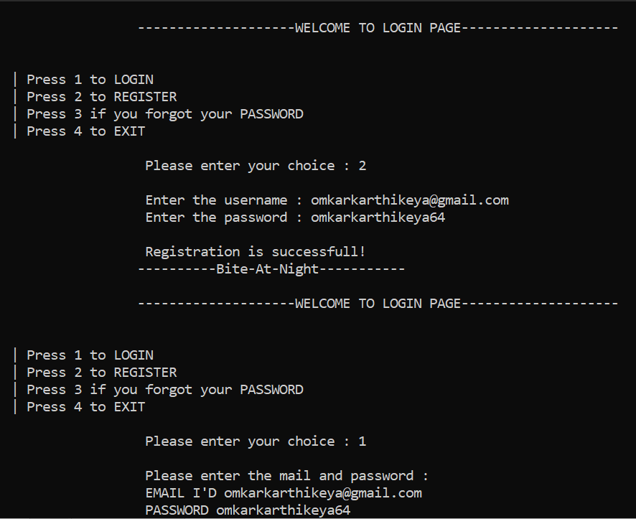
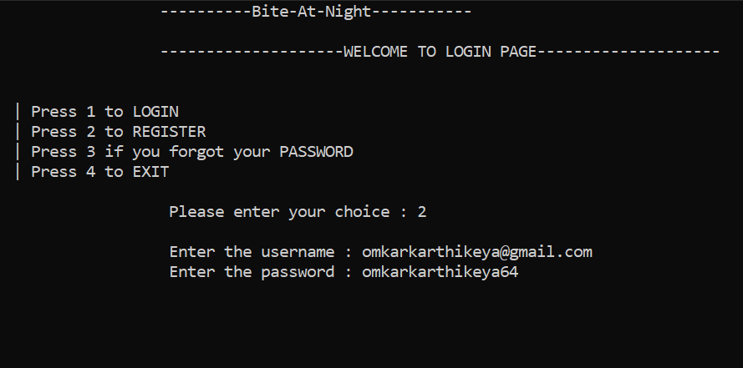
Register & Login

Slide 8
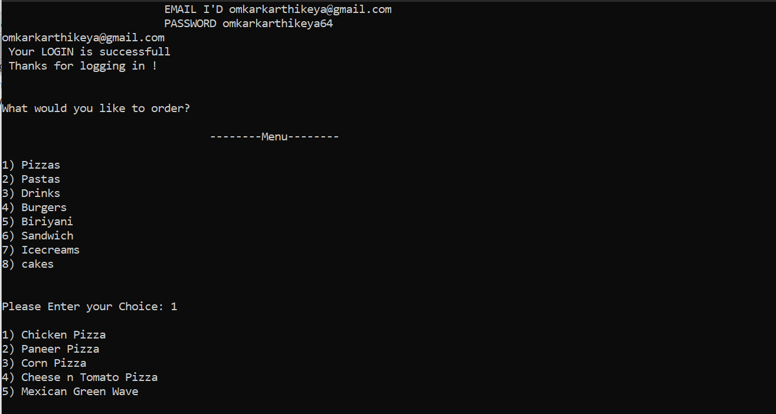
Menu & Choice

Slide 9
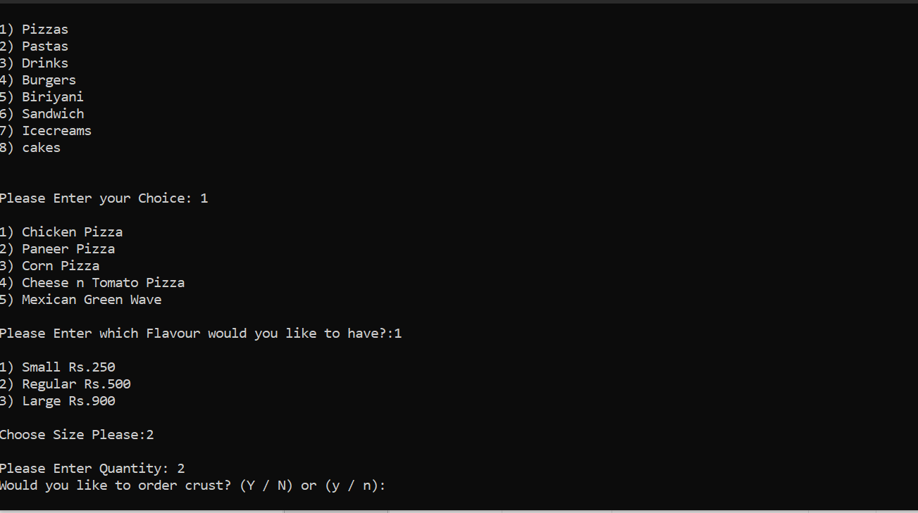
Size & Quantity

Slide 10
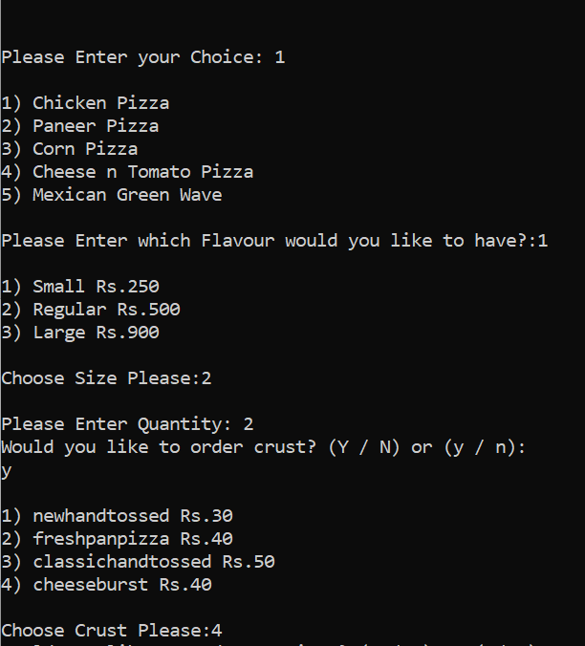
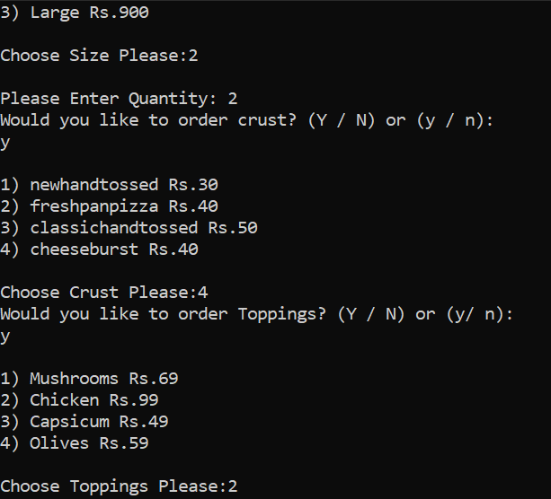
Crust & Toppings (for Pizza)

Slide 11
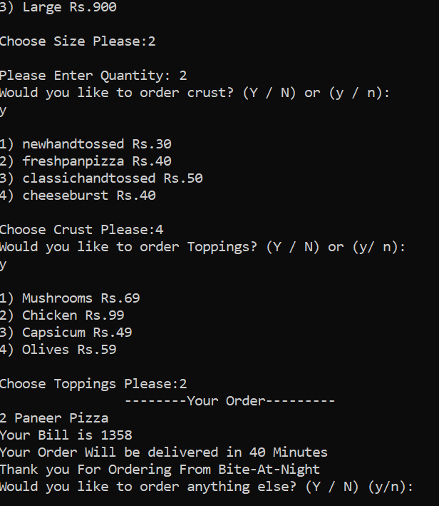
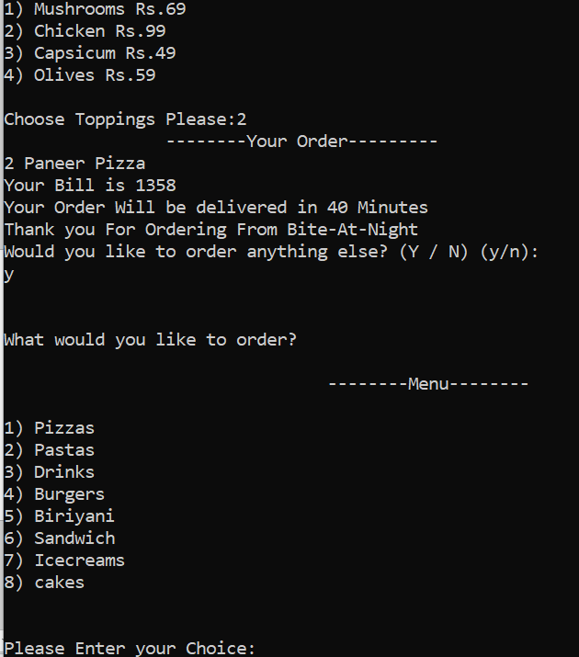
Order Details & Order again

Slide 12
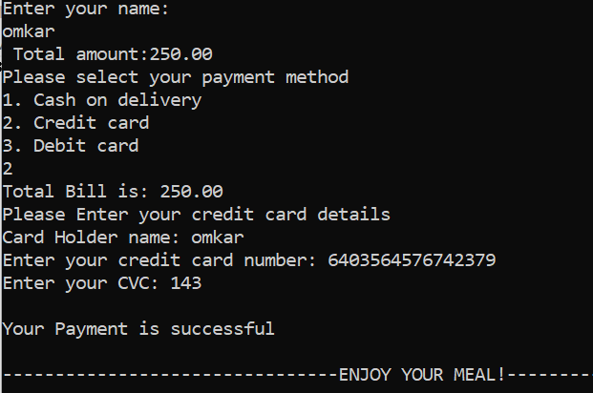
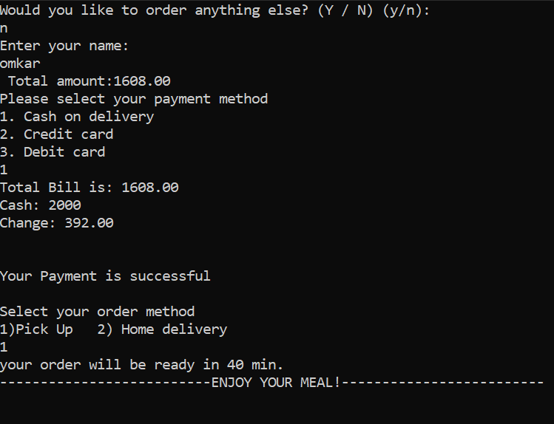
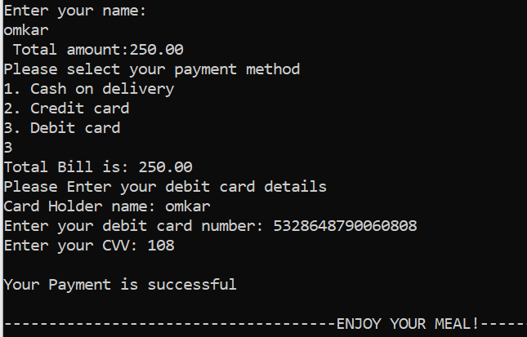
Payment Methods

Slide 13
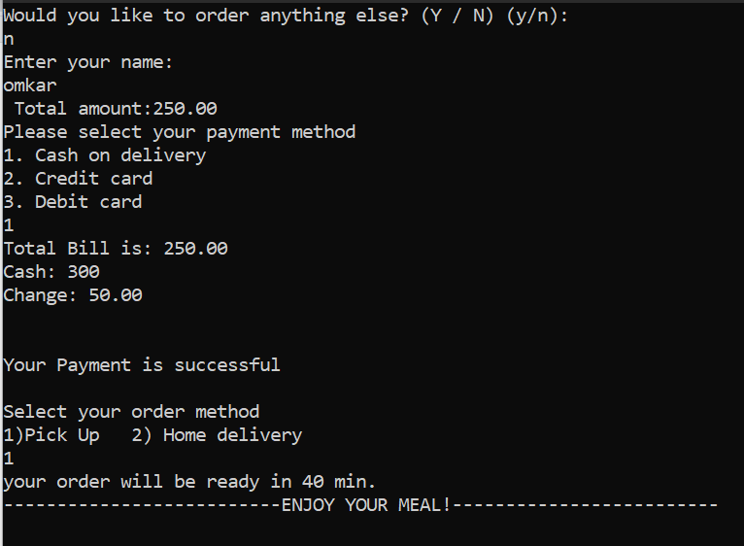
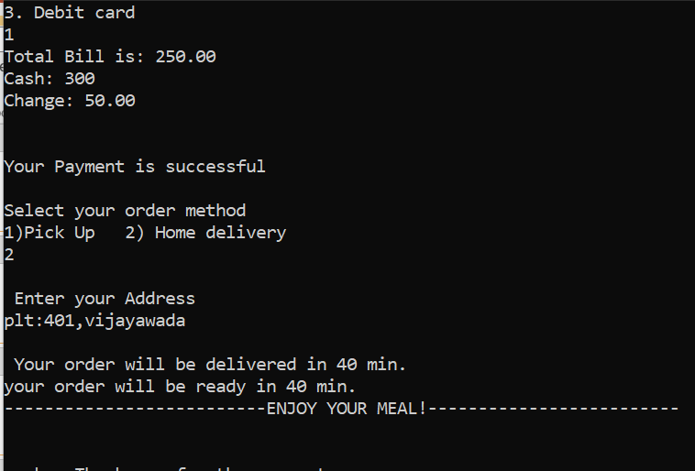
Order Method

Slide 14
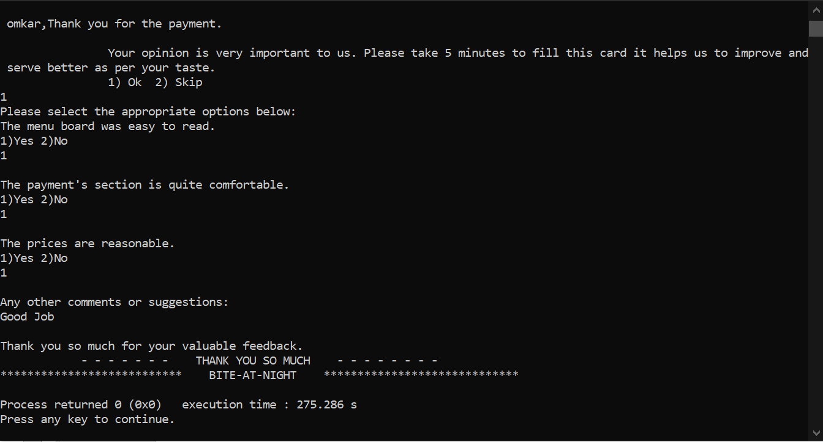
Feedback

Slide 15
BITE-AT-NIGHT
Thank you

